Slide 1
Function Rerouting from Kernel Land with “Hades”
Jason Raber
Director of Cyber Research Lab
Riverside Research

Slide 2
Overview
Why it’s cool
Output
How it works
Poor man’s tutorial
It slices, it dices, …
Where to get it

Slide 3
Why it’s cool
“Some folks call it Hell, I call it Hades.”
Hooks both:
DLL APIs
Internal functions
Motivation:
Detours, WinAPIOverride without the weight
Gets around a lot of anti-debugging tricks
Free source code
Notes:
Detours, WinAPIOverride without the weight – When I saw that some malware was able to detect Detours and WinAPIOverride, I reversed the malware and determined that they were detecting if any unauthorized DLLs were being loaded. Detours and WAO work depend on this ability to work. So I created a system profiler that does not use DLL injection…
One machine to rule them all – You don’t need two machines as you normally do with any type of kernel debugging.
Gets around a lot of anti-debugging tricks:
Traditional Ring-3 debuggers (Olly, Immunity, and IDA Pro) need to register with the OS to begin debugging a user application because they need to handle an INT 3. This makes them easily detectable.
Using the Hades, registration with the OS is not required.
Checks for IsDebuggerPresent, INT 1, INT 3, and hardware debug register use are therefore circumvented.

Slide 4
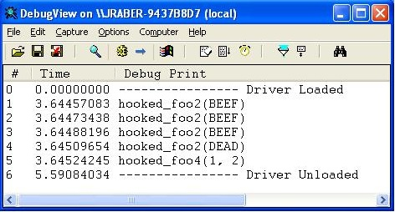
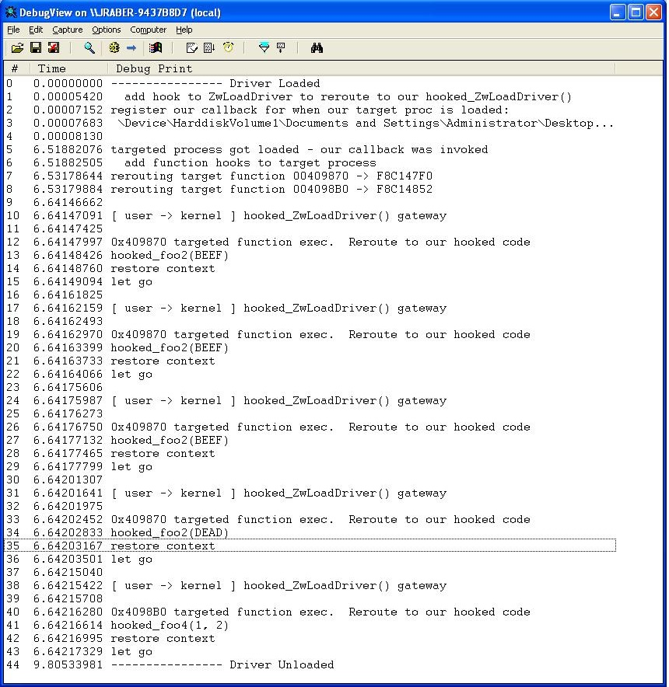
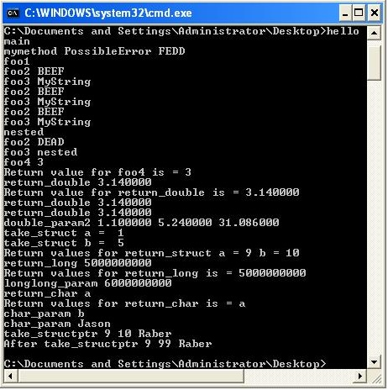
Output
Notes:
As you can see here is the output…a shorter version and verbose version

Slide 5
How it works
Target Process
(4)
IP
OEP
Foo2()
push ebp
mov ebp, esp
mov eax, [ebp]
push eax
Foo2()
jmp Trampoline
push eax
IP
(5)
5 bytes
Trampoline
(6)
(8)
pushad // registers
pushfd // flags
push 0x4098B0 // ID
jmp dword ptr MyHandler
MyHandler:
mov eax, 0x61 // ZwLoadDriver ID
mov edx, esp
_emit 0x0F // SYSENTER
_emit 0x34
User
Kernel
(2)
(3)
(1)
Hades
(7)
Kernel
LoadDriver()
1. Hook LoadDriver()
2. Copy Trampoline Code
3. Inject function reroute
IP
push ebp hooked_LoadDriver()
mov ebp, esp print func, params
mov eax, [ebp] restore_context()
jmp ID+6
Notes:
1 – Hook LoadDriver()..could be any syscall you want really
2 – Copy our trampoline code, which allows us to pass control from user to kernel space.
kernel-user-shared” memory (called SharedUserData)
3 – Inject a JMP into the functions we want to re-route to our trampoline. These could be internal functions or DLL system calls.
4 – Let go…In other words the OEP will begin executing and eventually hit our injected JMP at the beginning of the function. Once that happens the IP is redirected to the shared memory area (trampoline), where we save off the context and cause an interrupt to our hooked system call.
5 – We land in our hooked syscall. There we print out the registers, parameters, and function name.
6 – Execute instructions that were stolen from the targeted process, then jump back to the targeted process, offset by however many bytes you stole because the jmp is still in place in the targeted process.
2 – More on: Trampoline address space is “kernel-user-shared” memory (called SharedUserData). Basically two virtual addresses map to the same physical address. Kernel address = 0xFFDF0000, User address = 0x7FFEE0000. One of the purposes of SharedUserData is to provide processes with a global and consistent method of obtaining certain information that may be requested frequently, thus making it more efficient than having to incur the performance hit of a system call. Furthermore, as of Windows XP, SharedUserData acts as an indirect system call re-director such that the most optimized system call instructions can be used based on the current hardware's support (e.g. by using sysenter over the standard int 0x2e). . We can now use this area as our scratch space and transition to kernel land from a user process. We just offset the 0x7FFE000 by 0x800 to skip past Windows function pointers.

Slide 6
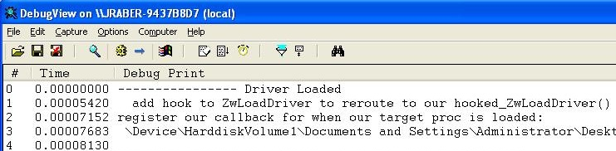
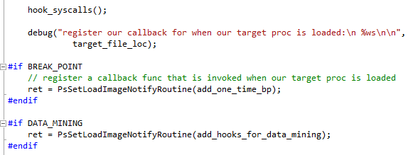
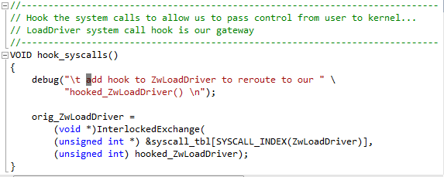
Poor man’s tutorial
DriverEntry()
Hook system call
Register callback
Notes:
1 - Before running the targeted process, load our driver. Once the driver is loaded it will hook the system call “LoadDriver”.
2 - Once we have a hook in the syscall table for LoadDriver, we register a callback function to notify our driver if the targeted process gets loaded in user space.

Slide 7

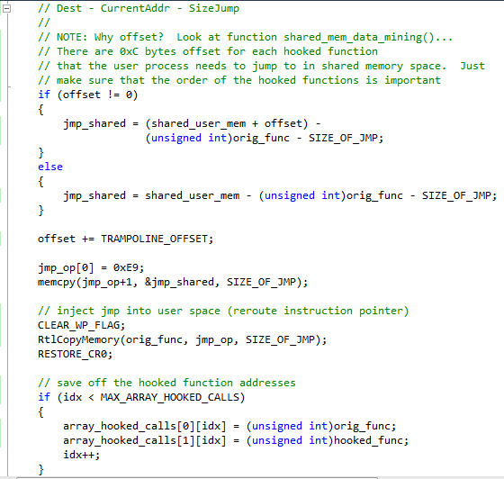
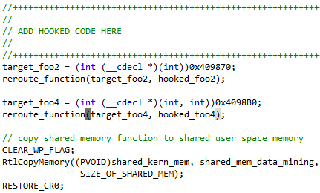
Poor man’s tutorial
reroute_function()
add_hooks_for_data_mining()
Notes:
OEP has not executed yet…just our callback. We need to add our function re-routing hooks to the process that is now loaded in memory, then let go. The instruction pointer will land at OEP and execution will begin.

Slide 8
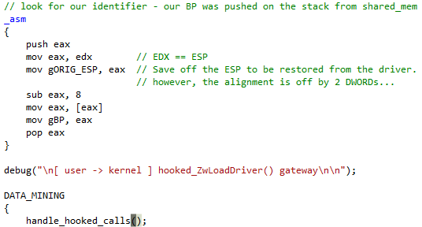
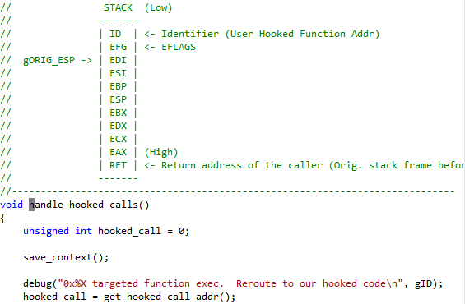
Poor man’s tutorial
Trampoline
hooked_ZwLoadDriver()
pushad // registers
pushfd // flags
push 0x4098B0 // ID
jmp dword ptr MyHandler
MyHandler:
mov eax, 0x61 // ZwLoadDriver ID
mov edx, esp
_emit 0x0F // SYSENTER
_emit 0x34
handle_hooked_calls()
Notes:
1 - Now the re-routed function in the target process has been executed.
2 - Pass control to the trampoline, which invokes an interrupt that will send execution to the hooked_ZwLoadDriver(). Find the stack pointer and save it off, then call handle_hooked_calls(). As you can see, on the stack is our ID (virtual address), eflags, and registers that we saved off in the trampoline code.
3 - Next check the address of the hooked call since we might have multiple hooked calls and we need to know which one to call next.

Slide 9

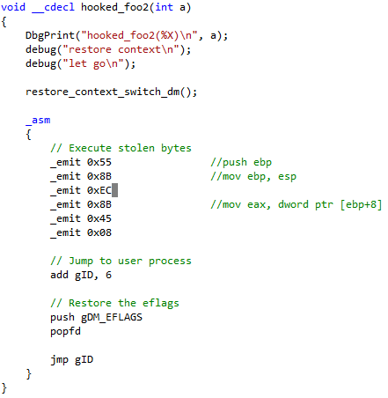
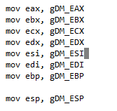
Poor man’s tutorial
Notes:
To wrap up we need to print out the function with the parameters, restore the context, then execute the stolen bytes before returning back to the process.
Beware of control flow instructions from user space that is executed in kernel space – this can cause bad things to happen. In general though, most code for functions are using calling conventions like cdec or stdcall that has prolog code that does not use jumps or calls.

Slide 10

It slices, it dices, …
…it even debugs!
If we can reroute function calls, why not instructions?
Limited to one breakpoint right now
One-time use breakpoint
Modify away and share ☺

Slide 11
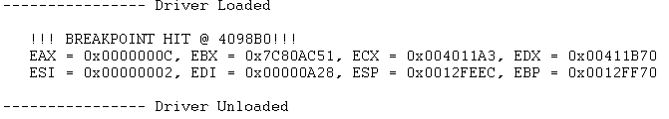
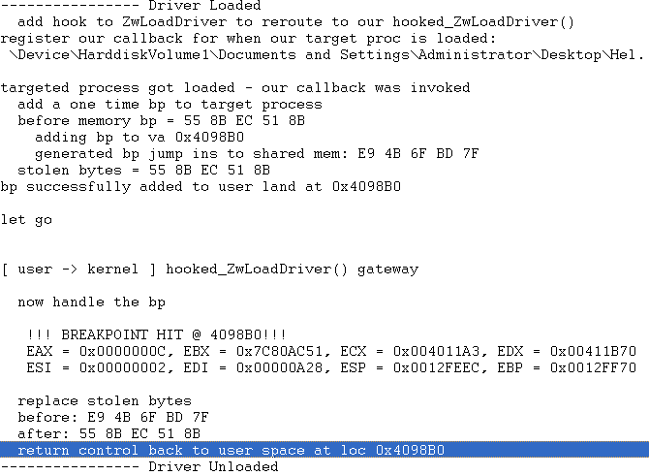


Debugger fun
Short view
Make these modifications
before adding breakpoint
Verbose view
hades.h
debugger.h
Notes:
Here we use the same basic idea as our approach to function re-routing, but it is even simpler. We are still using the same gateway or protocol with the SharedUserData, as well as using the “LoadDriver” hooked function to handle the interrupts.

Slide 12
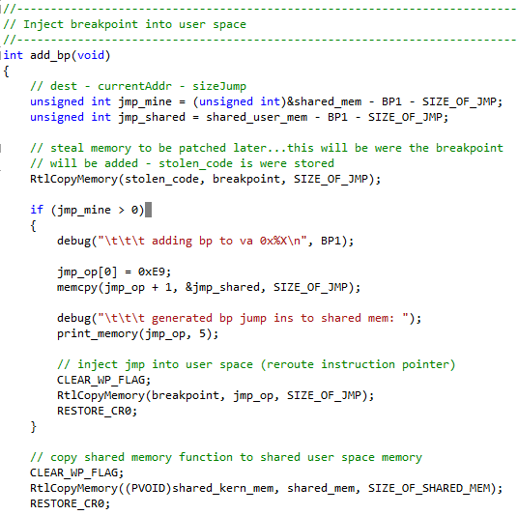
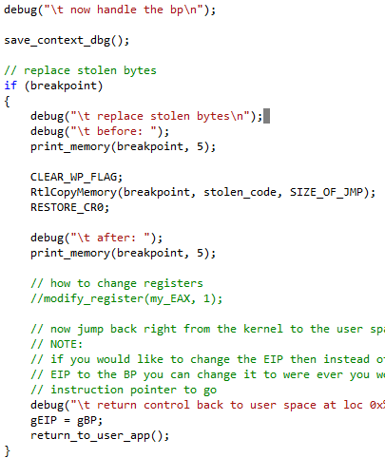
Debugger fun
Inject the runtime breakpoint
Breakpoint has been hit: handle_bp()
Notes:
1 - Once our callback function add_one_time_bp() is invoked then we want to call add_bp() that injects the function rerouting into the user process
2 - Then copies this function into the shared kernel/user memory area.
//-----------------------------------------------------------------------------
// This is the area of memory that will be shared with kernel and user process
//-----------------------------------------------------------------------------
void __declspec(naked) _cdecl shared_mem(void)
{
_asm {
pushad /* push all registers */
push BP1 /* my identifier to filter on */
mov eax, 0x61 /* ZwLoadDriver identifier */
mov edx, esp
_emit 0x0F /* sysenter */
_emit 0x34
}
}
//-----------------------------------------------------------------------------
// This function is used for the driver debugger, adjusts the stack and jumps
// back to the user process
//-----------------------------------------------------------------------------
void __declspec(naked) _cdecl return_to_user_app()
{
_asm
{
// since the gORIG_ESP is not the real orignal ESP I need to adjust it
// to really be pointing to the real stack before restoring registers
// and changing control back to the debuggee
mov eax, gORIG_ESP
sub eax, 8
// now adjust the stack pointer to point to were it was
mov esp, eax
pop eax // this is the BP
popad // pop all registers that were stored on the stack in
// shared_mem()
jmp gEIP
}
}

Slide 13
Where to get it
Available from github
https://github.com/jnraber/Hades
POC: Jason Raber
jraber@riversideresearch.org
Work: 937-427-7080
Cell: 937-848-1143

Slide 14
Questions?
?

